Slide 1
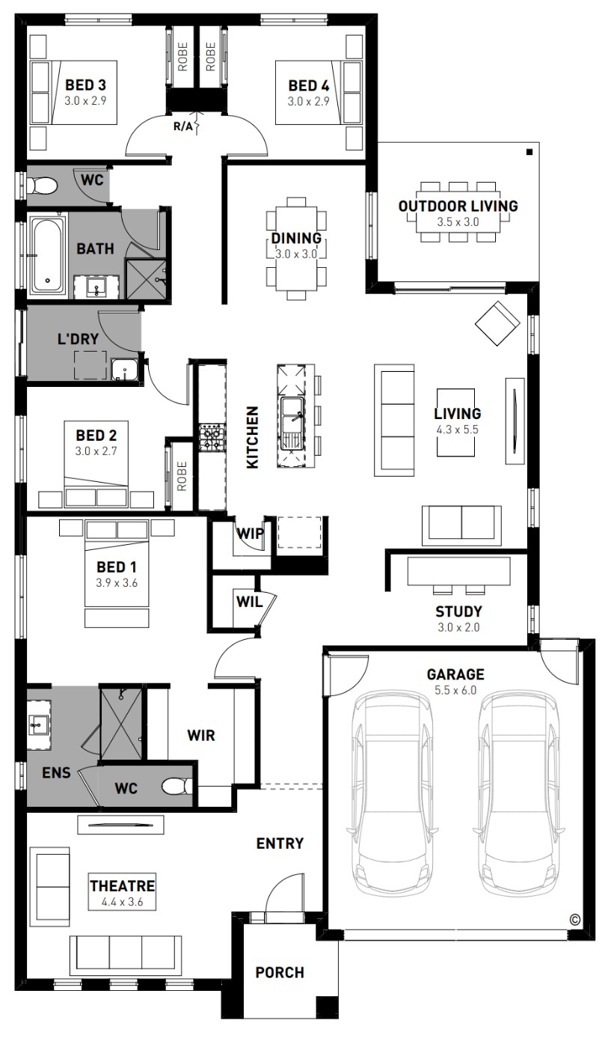
Add CGI
\\abn.group\bou2\boudata\Sales\Home & Land Info\_HBC\HBC CGIs
FROM package price
Add price
Add plan name
Willow 25
$638,230*
Update bed, bath, car
Add lot details
4
2
2
Neangar Green Estate, Eaglehawk – 484m²
Lot 10 Langhorne Close
Fixed site costs, estate and council requirements
Exposed aggregate driveway
Prescott façade included
Quality floor coverings throughout
Tiled kitchen splashback
Westinghouse stainless steel appliances, including electric induction cooktop
Choice of matt black or chrome tapware
Brick infills over windows
Double glazed windows with Low E coating, window locks and weather seals
Electric ducted heating and cooling to living areas and bedrooms
3.5kW Solar PV system
Seven Star Energy Efficiency on all orientations
Bushfire Attack Level upgrades
CFA rated water tank
Recycled water connection
25-year structural guarantee
12-month service warranty
Add façade name and any extra inclusions
OPTIONAL INCLUSIONS
NBN fibre optic pack
Opticomm fibre optic system
Recycled water connection
2550mm ceiling height to ground floor
Bushfire provision upgrades
Metal roof with whirlybird
Water tank
Add floorplan
\\abn.group\bou2\boudata\Sales\Home & Land Info\_HBC\NCC 2024 - HBC (jpeg)
Add your own contact details
*Price based on home type and floor plan shown and on builder’s preferred siting. Floor plan depicts a traditional facade, modern facade shown and included in price. Image used is an artist impression for illustrative purposes only and may show decorative items not included in the price shown including path, fencing, landscaping, coach lights and furnishings. “From” pricing means that, subject to the terms of this disclaimer and any owner requested changes, the price advertised will be subject to change once fixed site costs and developer guidelines are confirmed. The price is based on an estimate and final pricing may vary if actual site conditions differ to those shown in these developer supplied documents Block and building dimensions may vary from the illustration and the details shown. For more information on the pricing and specification of this home please contact a New Homes Consultant. ABN Group Victoria has permission of the owner of the land to advertise the land as part of the price specified. The price does not include transfer duty, settlement costs, community infrastructure levies imposed or any other fees or disbursements associated with the settlement of the land. Dec-24
Alex McLean
New Homes Consultant
0434 111 282
alexm@hombuyers.com.au

